Slide 1
JPEG Compression

Slide 2
The JPEG Standard
JPEG is an image compression standard that was developed by the “Joint Photographic Experts Group”. JPEG was formally accepted as an international standard in 1992.
JPEG is a lossy image compression method. It employs a transform coding method using the DCT (Discrete Cosine Transform).
An image is a function of i and j (or conventionally x and y) in the spatial domain.
The 2D DCT is used as one step in JPEG in order to yield a
frequency response which is a function F(u, v) in the spatial
frequency domain, indexed by two integers u and v.
Notes:
Motivation

Slide 3
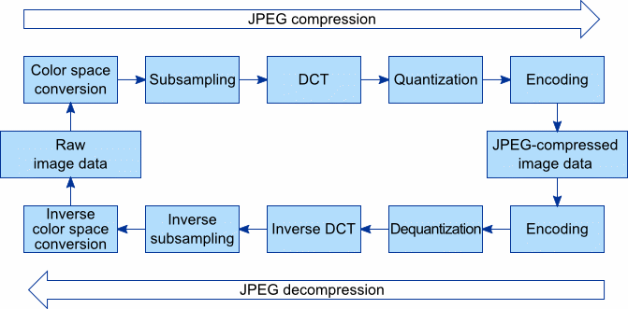

Slide 4
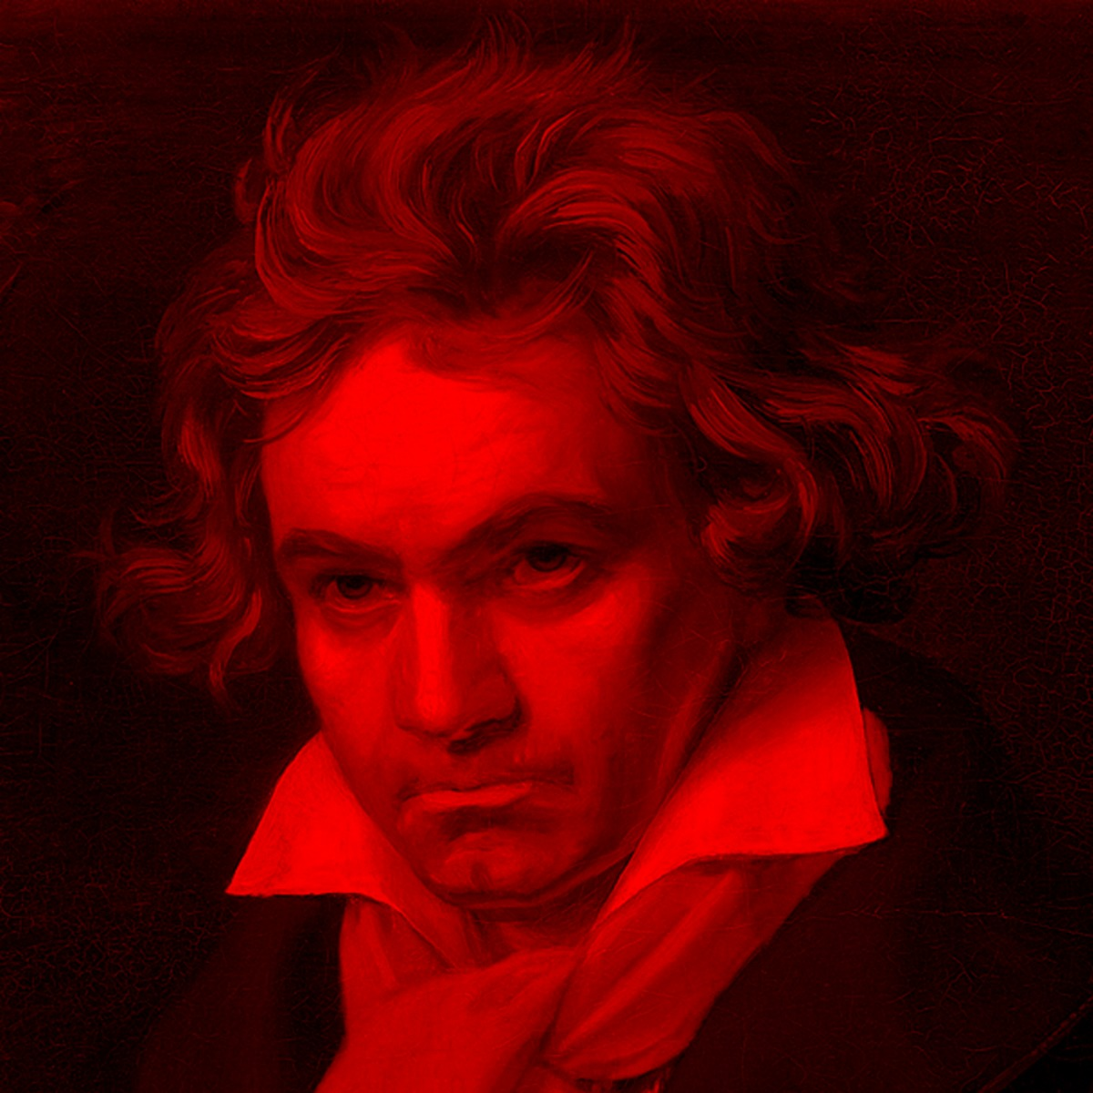
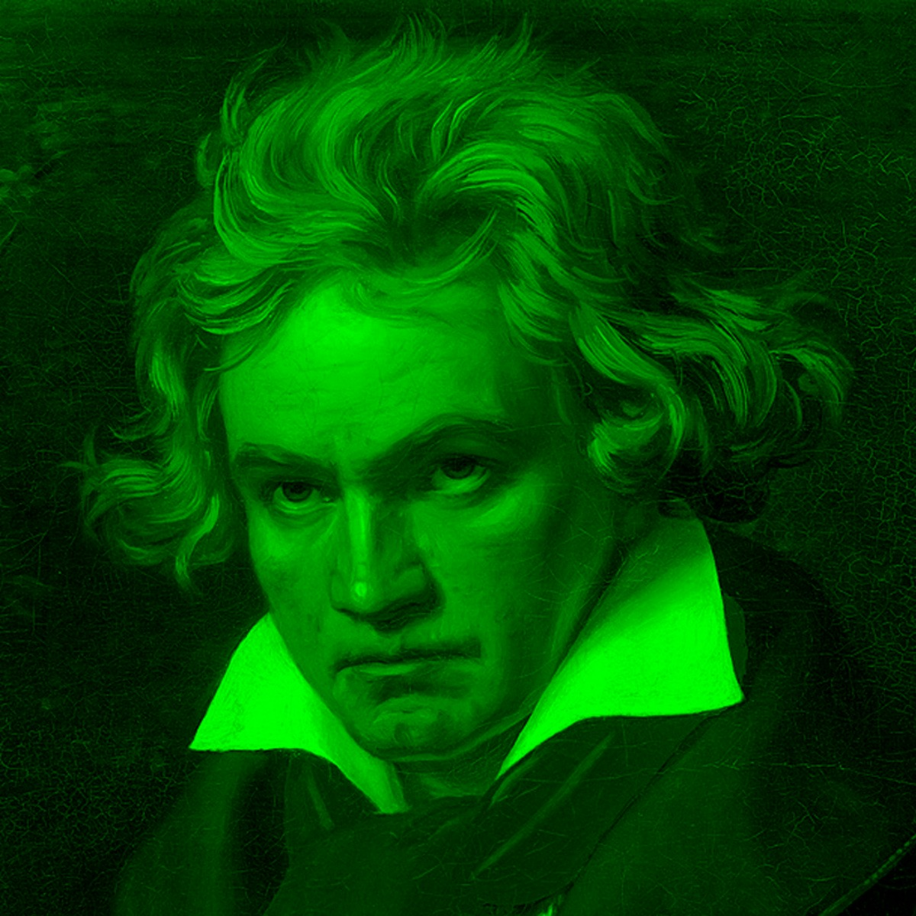
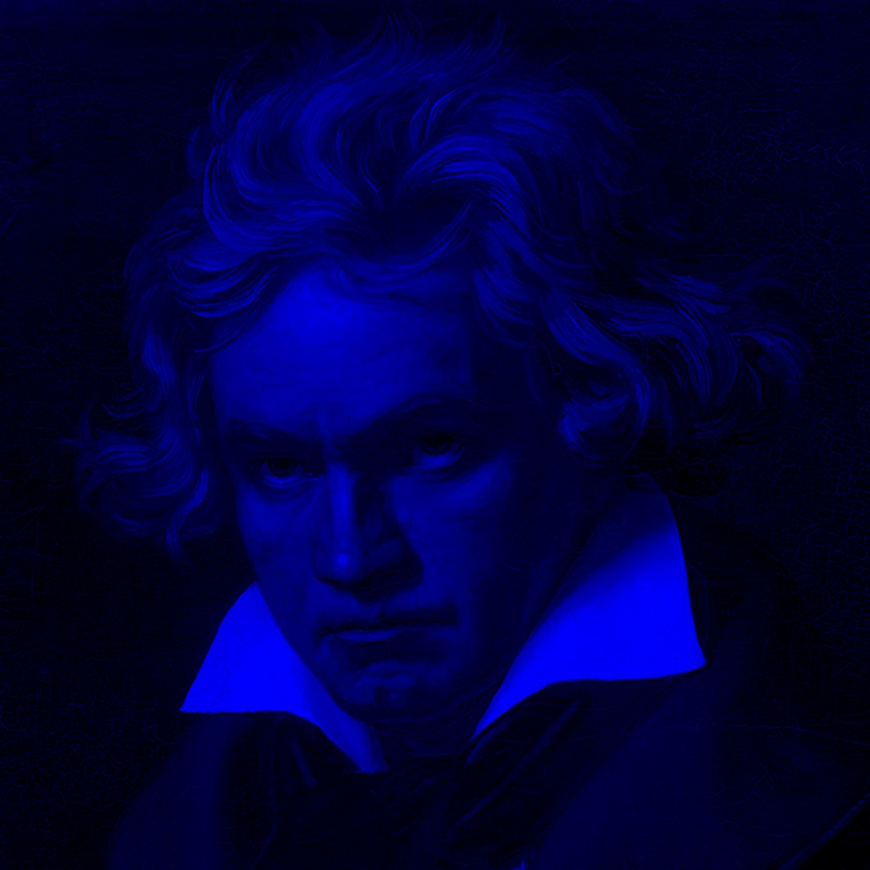
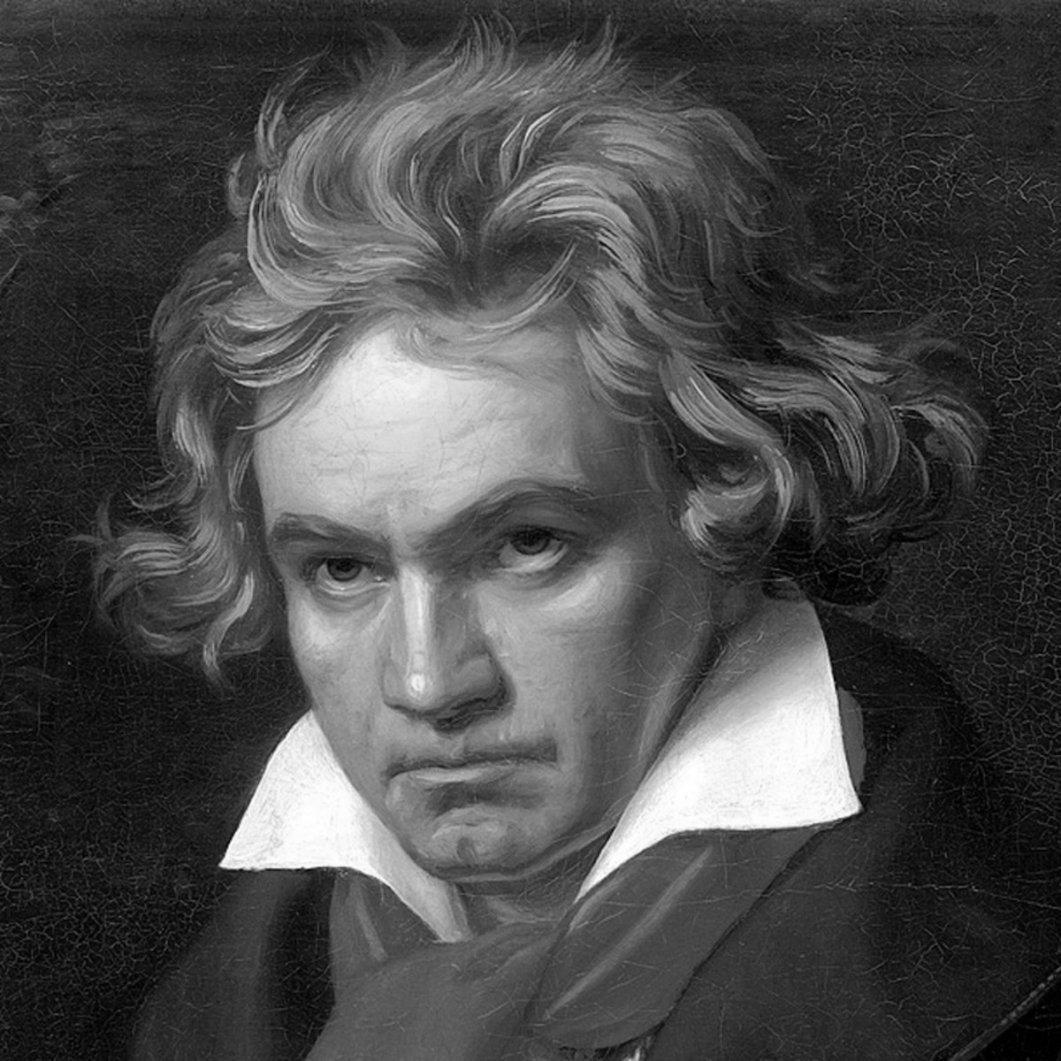
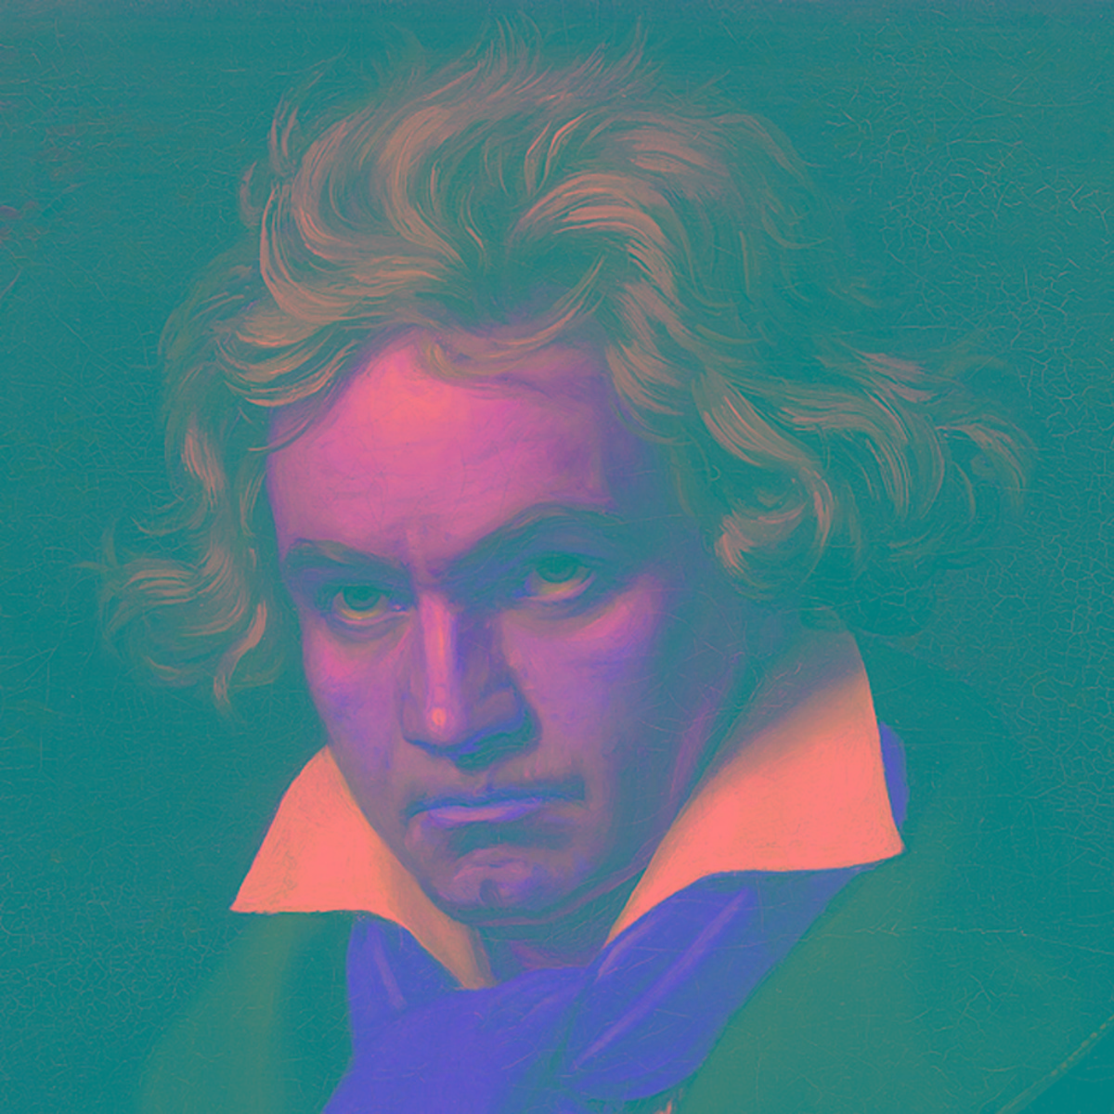
Space Transform and sub-sampling
The images values are transformed from RGB to luminance/chrominance color space.

Slide 5


Color Models
Additive and subtractive

Slide 6
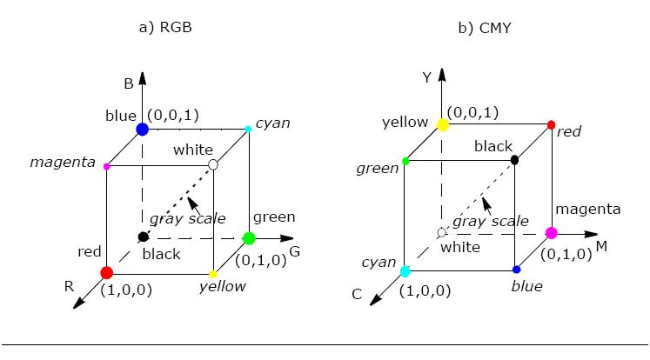

Slide 7
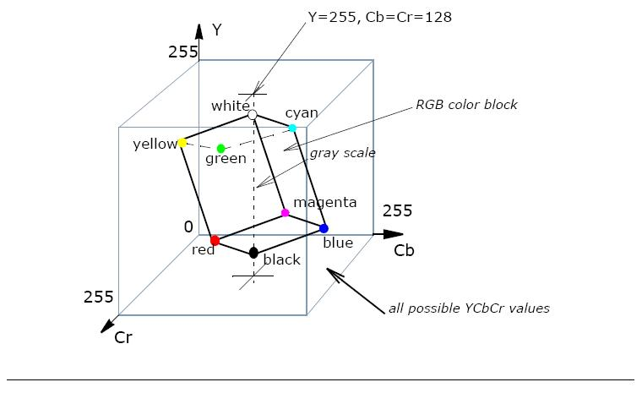

Slide 8
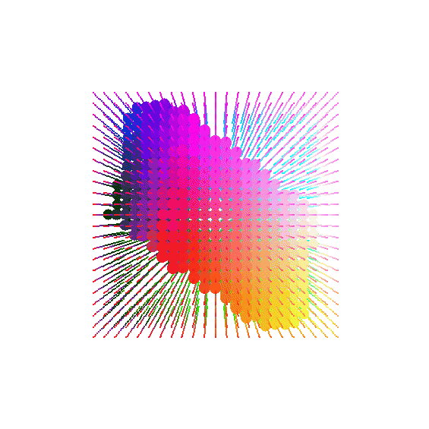

Slide 9
Y’CbCr
Y=0.299(R-G) + G + 0.114(B-G) Cb=0.564(B-Y) Cr=0.713(RY)
Y’CbCr color model contains Y’, the luminance component and Cb and Cr are the blue-difference and red difference chrominance components.
It is not an absolute color space. It is mainly used for digital systems
Its common applications include JPEG and MPEG compression.
Y’UV is often used as the term for Y’CbCr, however they are totally different formats. The main difference between these two is that the former is analog while the later is digital.

Slide 10
Preprocessing for DCT
• At step 2 which is preprocessing for DCT, first the image is separated into non-overlapping blocks where each block is 8X8 pixels (64 pixels per block).
• Then normalize the pixels value to -128 to 127 from 0 to 255, just by subtracting 128 from each pixel value.
[74, 66, 59, 64, 70, 74, 82, 82],
[74, 66, 59, 64, 68, 76, 85, 84],
[72, 66, 59, 64, 70, 78, 90, 85],
[74, 72, 66, 68, 72, 80, 87, 78],
[76, 78, 74, 74, 76, 80, 84, 70],
[70, 74, 74, 78, 78, 84, 85, 74],
[66, 68, 70, 76, 78, 84, 89, 82],
[68, 70, 72, 76, 76, 78, 85, 84]
0 to 255
[-54., -62., -69., -64., -58., -54., -46., -46.],
[-54., -62., -69., -64., -60., -52., -43., -44.],
[-56., -62., -69., -64., -58., -50., -38., -43.],
[-54., -56., -62., -60., -56., -48., -41., -50.],
[-52., -50., -54., -54., -52., -48., -44., -58.],
[-58., -54., -54., -50., -50., -44., -43., -54.],
[-62., -60., -58., -52., -50., -44., -39., -46.],
[-60., -58., -56., -52., -52., -50., -43., -44.]
-128 to 127

Slide 11
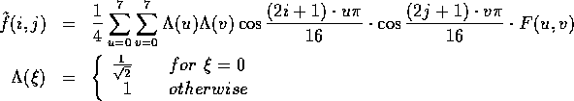
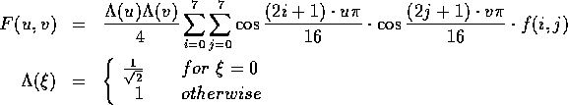
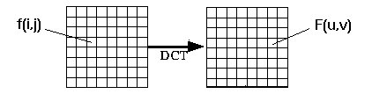
Discrete Cosine Transform (DCT)
From spatial domain to frequency domain:

Slide 12
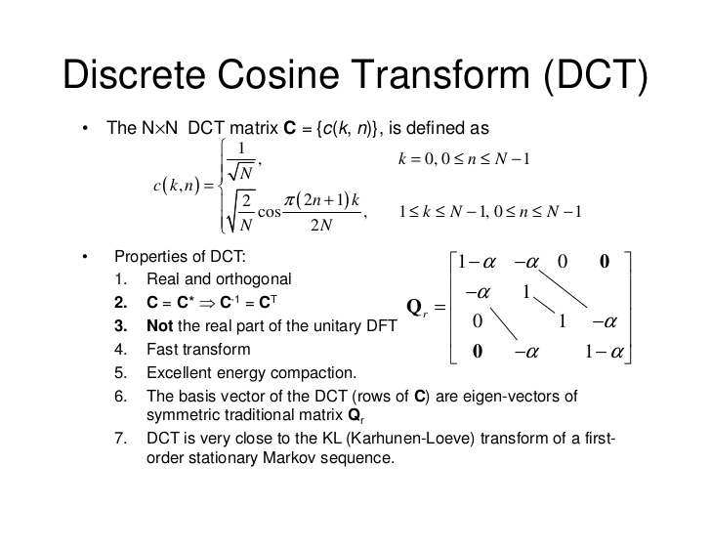

Slide 13
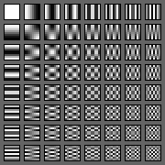
(8 x 8) DCT basis functions
This transforms the signal in frequency domain.
The authentic and significant feature of discrete cosine transform is it provides higher PSNR.
The performance of proposed technique over existing technique is superior due to discrete cosine transform.

Slide 14
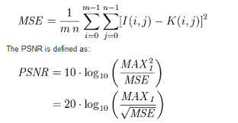
PSNR (Peak signal-to-noise ratio)
ratio between the maximum possible power of a signal and the power of corrupting noise that affects the fidelity of its representation.
The higher the PSNR, the better the quality of the compressed, or reconstructed image.
PSNR is most easily defined via the mean squared error (MSE). Given a noise-free m×n monochrome image I and its noisy approximation K, MSE is defined as:
Here, MAX_{I} is the maximum possible pixel value of the image. When the pixels are represented using 8 bits per sample, this is 255.

Slide 15
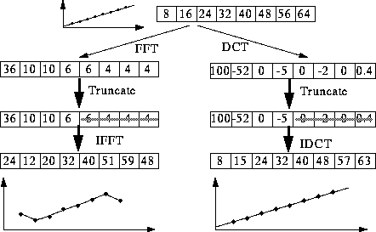
Properties
DCT is like FFT, but can approximate linear signals well with few coefficients

Slide 16
[-54., -62., -69., -64., -58., -54., -46., -46.],
[-54., -62., -69., -64., -60., -52., -43., -44.],
[-56., -62., -69., -64., -58., -50., -38., -43.],
[-54., -56., -62., -60., -56., -48., -41., -50.],
[-52., -50., -54., -54., -52., -48., -44., -58.],
[-58., -54., -54., -50., -50., -44., -43., -54.],
[-62., -60., -58., -52., -50., -44., -39., -46.],
[-60., -58., -56., -52., -52., -50., -43., -44.]
Normalized 8x8
[-4.2662500e+02, -4.0683823e+01, 1.5374504e+01, 1.4694376e+01, -6.1250000e+00, 8.6246281e+00, -8.9390097e+00, -4.5308480e-01],
[-1.5785168e+01, -3.3151827e+00, 1.9363781e+01, 7.5779009e+00, 5.3591881e+00, -3.6367449e-01, -5.2817518e-01, 4.8575968e-01],
[-5.5480852e+00, -9.2871256e+00, 3.6579320e+00, -4.7509637e+00, 7.6432285e+00, -1.1625942e+00, 1.8687183e+00, -1.4171985e-01],
[ 2.8853426e+00, 9.3085260e+00, -8.6005859e+00, 1.4271710e+00, 2.2666745e+00, -4.8465103e-01, 4.0271923e-01, -5.8980358e-01],
[-1.2500000e-01, 8.8876476e+00, -2.8021472e-02, -1.0007567e+00, -1.2500000e-01, -1.2700291e+00, -3.9429021e-01, 1.2580674e+00],
[-6.5984356e-01, -7.0869727e+00, 2.6922369e-01, 1.3689023e+00, 2.7438146e-01, 9.0595618e-02, -1.6873838e-02, 3.5555437e-02],
[-1.9914424e-03, -3.2623537e-02, -6.3128221e-01, -7.3771930e-01, 4.8714489e-01, -3.4994736e-01, -4.0793213e-01, 1.1472439e-01],
[ 7.3529854e-02, -6.6068667e-01, 4.4048622e-01, 6.3664526e-01, 5.9226837e-02, 2.5467762e-01, -1.1139845e+00, 1.2974157e+00]
DCT Coefficient

Slide 17
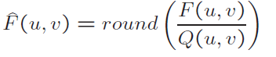
DCT Coefficient Quantization
F(u, v) represents a DCT coefficient, Q(u, v) is a “quantization matrix” entry, and represents the quantized DCT coefficients which JPEG will use in the succeeding entropy coding.
The quantization step is the main source for loss in JPEG compression.
The entries of Q(u, v) tend to have larger values towards the lower right corner. This aims to introduce more loss at the higher spatial frequencies - a practice supported by Observations 1 and 2.
Table 9.1 and 9.2 show the default Q(u, v) values obtained from
psychophysical studies with the goal of maximizing the compression ratio while minimizing perceptual losses in JPEG images.

Slide 18
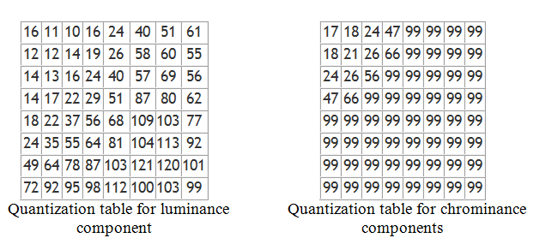

Slide 19
Purpose of quantization
reduce the total number of bits needed for a compressed image.
Low-frequency coefficients usually have more energy than high-frequency coefficients
Low-frequency coefficients require small quantization values.
The human visual system is more sensitive to low frequencies
Low-frequency coefficients require small quantization values.
The human visual system is more sensitive to luminance than chrominance
Luminance channels requires smaller quantization values than chrominance channels

Slide 20
DCT Coefficient Quantization
To change the compression ratio
Simply by multiplicatively scaling the numbers in the Q(u,v) matrix.
Quality factor
A user choice offered in every JPEG implementation
Linearly tied to the scaling factor
JPEG also allows custom quantization tables to be specified and put in the header.

Slide 21
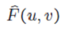
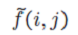
DCT Coefficient Quantization
f(i,j) – block image
F(u,v) - DCT coefficients for each block
Q(u,v) - Quantization matrix entry
- quantized DCT coefficients
- de-quantized DCT coefficients
- reconstructed image block
e(i,j) - error

Slide 22
DCT Coefficient Quantization
Figure 9.2, an image block is chosen at the area where the luminance values change smoothly.
Contains few high-spatial-frequency changes
Most of the DCT coefficients have small magnitudes
Figure 9.3, the image block chosen has rapidly changing luminance
Many more AC components have large magnitudes
The error e is larger than in Figure 9.2
JPEG introduce more loss if the image has quickly changing details.

Slide 25
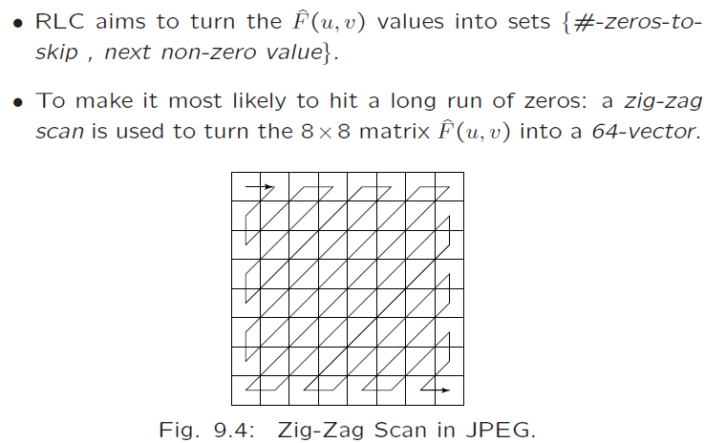
Zig-zag Scan

Slide 26
Zig-zag Scan
Zig-zag Scan turns the 8 x 8 matrix into a 64-vector.
Most image blocks tend to have small high-spatial-frequency components, which are zeroed out by quantization.
Zig-zag scan order concatenates long runs of zeros.

Slide 27
Preparation for Entropy Coding – run-length coding on ACs
The zigzag scan order has a good chance of concatenating long runs of zeros.
For example, in Figure 9.2 will be turned into
(32, 6, -1, -1, 0, -1, 0,0,0,-1, 0,0, 1, 0,0, …, 0)
Replace values by a pair (RUNGLENGTH, VALUE) for each run of zeros in the AC coefficients.
RUNLENGTH is the number of zeros in the run
VALUE is the next nonzero coefficient.
A special pair (0,0) indicates the end-of-block.
Not considering the first (DC) component, we will have (0,6)(0,-1) (0,-1)(1,-1)(3,-1)(2,1)(0,0)

Slide 28
Preparation for Entropy Coding – DPCM on DCs
DC reflects the average intensity values of each block. There is usually strong correlation between the DC coefficients of adjacent blocks.
The DC coefficients are coded separately from the AC ones. Differential Pulse Code Modulation (DPCM) is the coding method.
If the DC coefficients for the first 5 image blocks are 150, 155, 149, 152, 144, then the DPCM would produce 150, 5, -6, 3, -8, assuming d_{i} = DC_{i+1} − DC_{i}, and d₀=DC₀.
DPCM for the DC coefficients in JPEG is carried out on the entire image.

Slide 29
Entropy Coding
The DC and AC coefficients finally undergo an entropy coding step to gain a possible further compression.
Use DC as an example: each DPCM coded DC coefficient is
represented by (SIZE, AMPLITUDE),
SIZE indicates how many bits are needed for representing the coefficient,
AMPLITUDE contains the actual bits.
In the example we're using, codes 150, 5, −6, 3, −8 will be turned into
(8, 10010110), (3, 101), (3, 001), (2, 11), (4, 0111) .
SIZE is Huffman coded since smaller SIZEs occur much more often.
AMPLITUDE is not Huffman coded, its value can change widely so Huffman coding has no appreciable benefit.

